Slide 1
social media app
SocialShare

Slide 2

Project on Social Media a lication
Submitted by, Prajapati Ashish. D
BCA Semester - VI Guided by
Submihed to
Matrushri L.J.Gandhi (Bakorvala) B.C.A.College
Dr.N.J Shah P.G.D.C.A College, Modasa

Slide 3
Project Profile
Type of Application
Front End
Back End Tools Used Internal Guide External Guide Group No
Web Application Reactjs Nodejs, MySql
Visual Studio Code Mrs. Hemali patel Dr. J. H. Trivedi
3
Developed By
Prajapati Ashish. D
Submitted To
Matrushri L.J.Gandhi (Bakorvala) B.C.A.College & Dr.N.J Shah P.G.D.C.A College, Modasa

Slide 4

Existin stem
Limited Interactivity: the existing system has limited features
Security concerns: existing system may have vulnerabilities related to users data privacy
Bad User experience: user experience feels less familiar and engaging for the users

Slide 5

New S stem
highly Interactive: new system provides features such as follow, post an image, like and comment.
Enhanced security: In new system, we have taken a lots of steps to ensure better privacy for users
Better User experience: allows the users to personalize their profiles with di0erent themes and layouts

Slide 6
Server Software
Requirement
Hardware Requirement
80 GB HD
Hardware
Software Requirement
1. Express js
2. Pentium 4 Processer or above
2. MySQL Community Server 8.3.0
3. 512 MB RAM or Higher

Slide 7
Client Software
Requirement
Hardware Requirement
80 GB HD
Hardware
Software Requirement
1. Windows, Linux or Mac
2. Pentium 4 processer or
above
2. Can run on any modern browser like Chrome, Firefox, brave, edge, safari, arc etc.
3. 256 MB RAM

Slide 8
System Flow
Chart

Slide 9
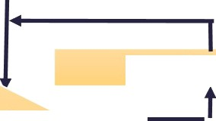

start
user
Registration
Login
No
Yes
view/Home page posts like/comment
Log out
stop

Slide 10
Data Flow Diagrams

Slide 11


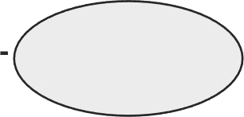


Definition:-
“Data flow diagram is a graphical aid for, defining systems
inputs, processes
and output. It represents flow of data through the system.”
Symbols:
Process:
“Here flow of data is transformed.”
externaI entity:-
“A source or destination of data which is external to the system.”
(3) Data Flow:-
“it is a packet of data. It may be in the form of document.”
(4) Data Store:-
“any stored data but with no reference to the physical method of string.”

Slide 12
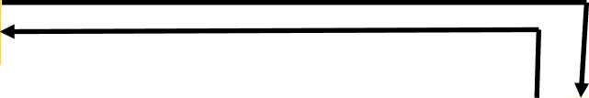
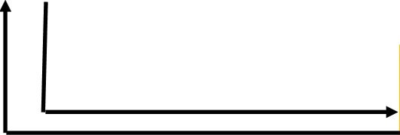
Context Level DFD [0
Level]
LO n re UeSt
U S E R
g q
Respons
e
0.0
SocialShare
Request
Server
Response

Slide 13







irst ievel
D(U

Slide 14
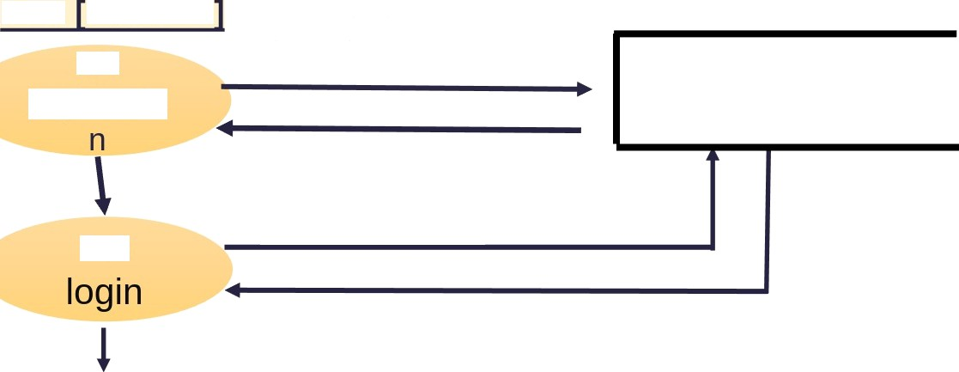
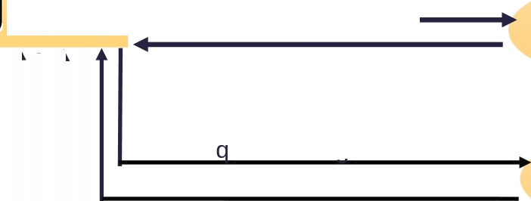




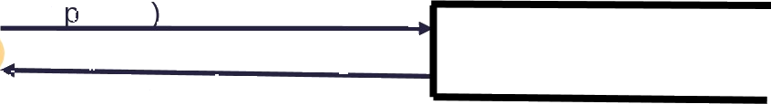







DFD Level - 1
£tO
Store data if user not exist already
Request for registration
user Table
Response with message (User registered successfully)
Response
Check user details(username and password) if exists
Re uest for looin
Response
Manage Post and store user ID(which
Redirected to the home page
Upload a post
Posts Table
Response
Response Manage Likes and store
user ID
Liked a post
•
Likes Table
Increase the like count
Response
g g
Check post id (user
comments on which post)
Comment under the post
Comment
s Table
Attach comment under the post
Response

Slide 15
ER-Diagram

Slide 16
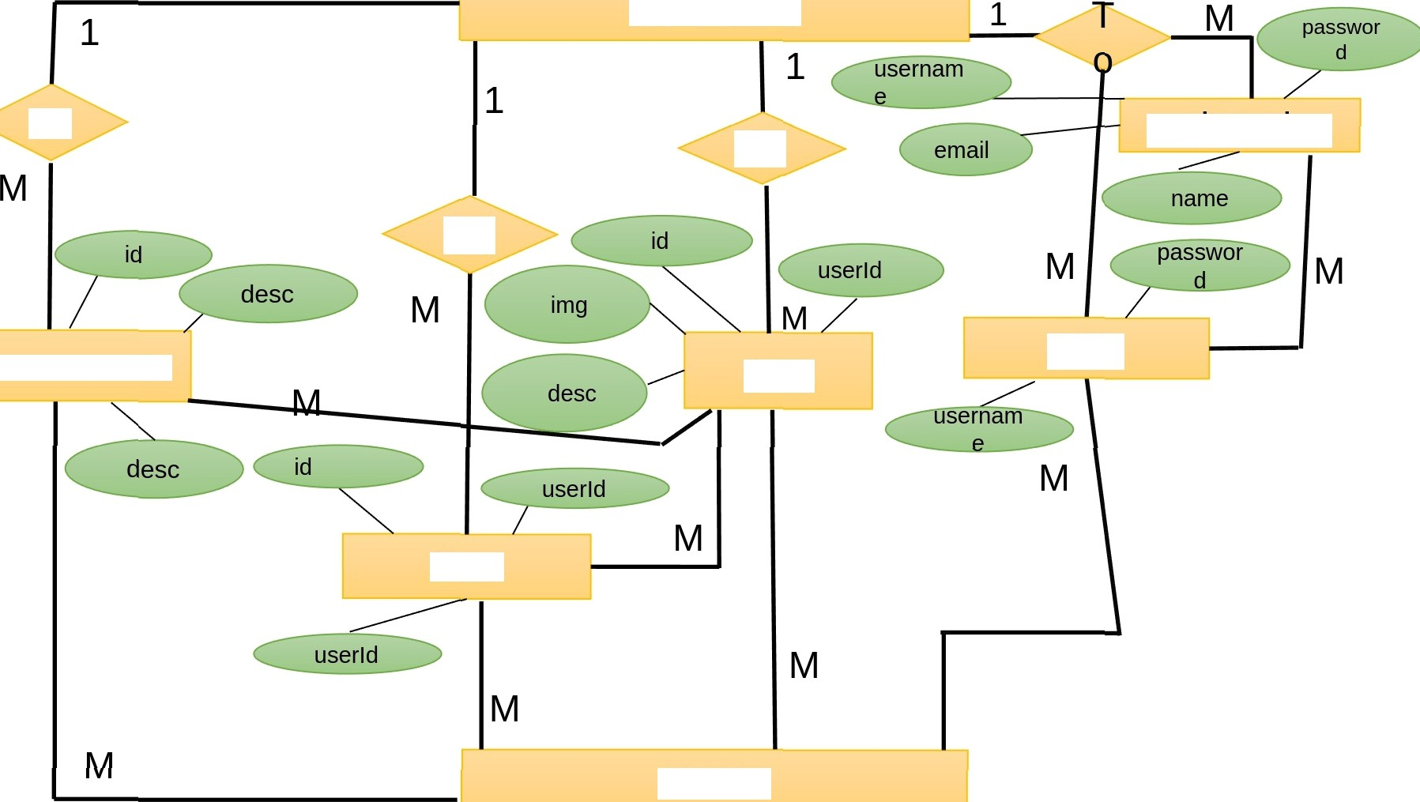
Server
To
registration
To
To
comments
login
post
likes
USER

Slide 17

Data Dictionar
Database Name: social
Tables:-
No | Table Name
1 | users
2 | posts
3 | likes
4 | comment
5 | relationships
6 | stories

Slide 18
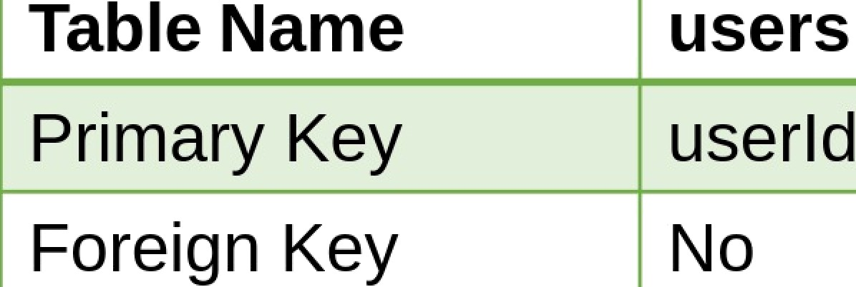
Table Name Primary Key Foreign Key
1. users
| users userld No
SR NO. | FIELD NAME | DATA TYPE | CONSTRAINT
1 | userld | INT | Primary Key
2 | username | Varchar(100) | Not Null
3 | password | Varchar(200) | Not Null
4 | email | Varchar(200) | Not Null
5 | name | Varchar(50) | Not Null
6 | ProfilePic | Varchar(300) | Not Null

Slide 19


osts |  | Table Name |  | posts
 |  | Primary | Key | id
 |  | Foreign | Key | userld (users Table)
SR NO. | FIELD NAME |  | CDATA TYPE | tCONSTRAINT
1 | id |  | )INT | Primary Key
2 | desc |  | Varchar(300) | )Not Null
3 | img |  | Varchar(300) | Not Null
4 | userld |  | )INT | Foreign key

Slide 20



likes
Table Name | likes
Primary Key | id
Foreign Key | userId(users), postId(posts)
SR NO. | FIELD NAME | DATA TYPE | CONSTRAINT
 | id | INT | Primary Key
2 | userld | INT | Foreign Key
 | postld | INT | Foreign Key

Slide 21
4. comments
TableName | comments
Primary Key | id
Foreign Key | userld(users), postId(posts)
SR NO. | FIELD NAME | DATA TYPE | CONSTRAINT
1 | id | INT | Primary Key
2 | desc | Varchar(200) | Auto
3 | postld | INT | Foreign Key Foreign Key
4 | userld | INT
5 | createdAt | DATETIME | Not Null

Slide 22
5. relationships
Table Name | relationships
Primary Key | id
Foreign Key | followerUserld(users),foIIowedUserId(users)
SR NO. | FIELD NAME | DATA TYPE | CONSTRAINT
1 | id | INT |  | Primary Key
2 | desc | Varchar(200) | Auto
3 | postld | INT | Foreign Key
4 | userld | INT | Foreign Key
5 | createdAt | DATETIME | Not Null

Slide 23
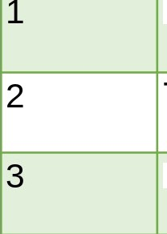

6. stories
Table Name | stories
Primary Key | id
Foreign Key | userld(users)
SR NO. IFIELD NAME | DATA TYPE | ICONSTRAINT
id | INT Varchar(300) | Primary Key Not Null
userld | INT | Foreign Key

Slide 24
Featu
Register with username, Email, Password and name
share
Lo;/in with username and password
Delete created oust
Create new posts
Light and dark mode Toggle
Like
Put stop
comment

Slide 25






Technoiogies Used
JSON
Lightweight data-interchange format
1. React-js
Node.js
2. ReactDOM
3. React-Router
Express.js
Scss - css preprocessor
Bcryptjs - for Hashing
passwords
Yarn - Javascript package manager
„„„ ,, MySql - database

Slide 26
Login page
Login

Slide 27

Registration Page
Register
testing
iestingšgmaiI.com
e
Login
iestingNamğ

Slide 28

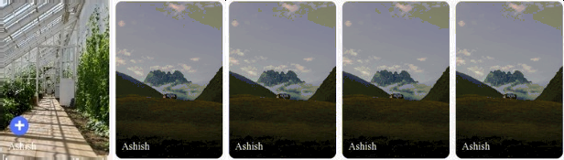


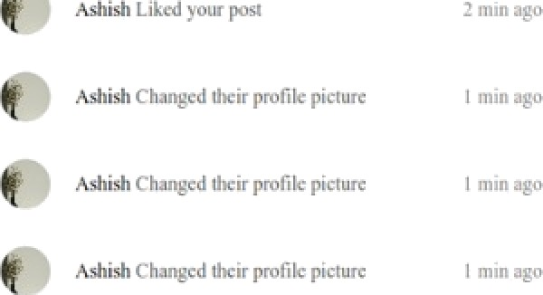


Light mode
Home page

Slide 29
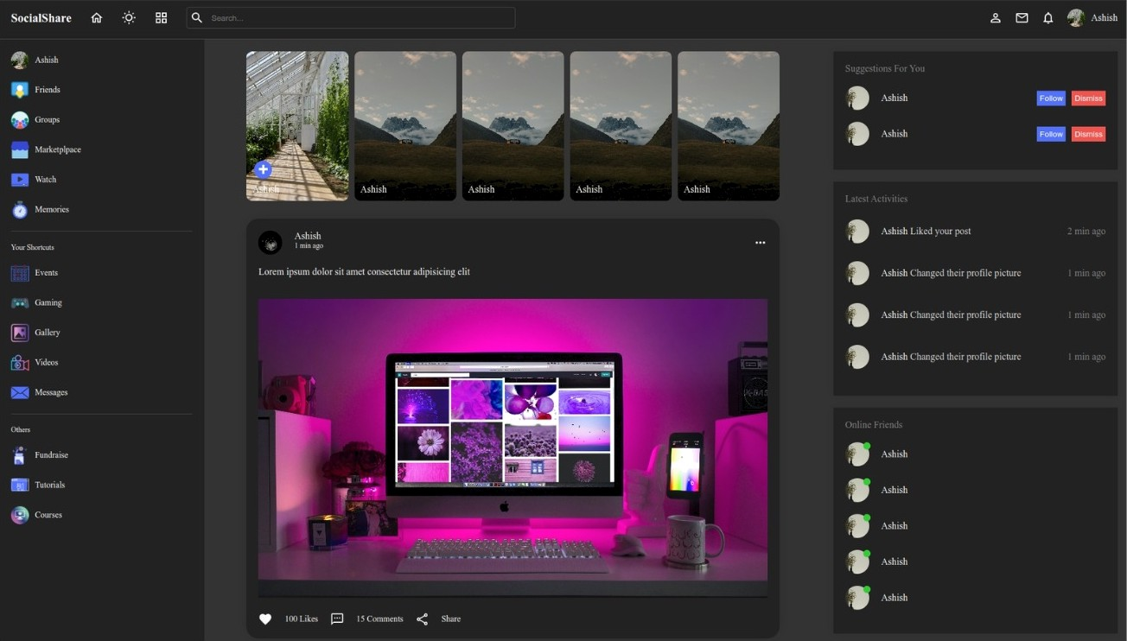
Dark mode
Home page

Slide 30
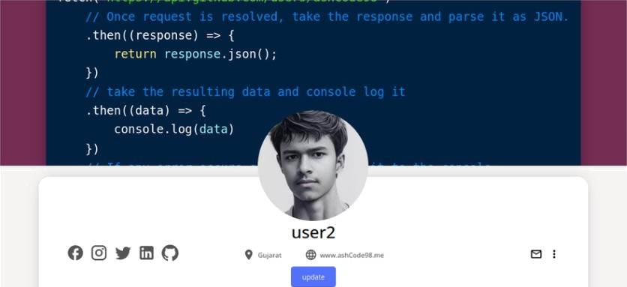




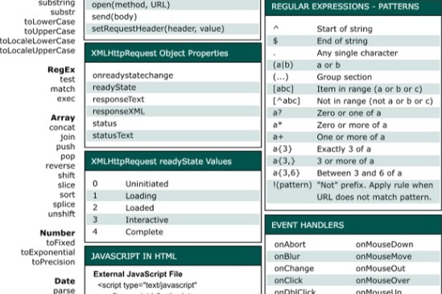





User Profile page
i ' user 2
Suggesnons For You
Ashidi changed their co\her piCtuFe
1 min ago
Ashish changed their ‹over picture
Ashish changed cheer cover piccure A$ftiSt cha nged their cover piriure
Or line Fr ier de
romovoEmntlantonor
Ashish
30

Slide 31


mys qT
'mysql”;
db mysql . cr ed eCon neck ąon(
user: " root " ,
pas sword : ,
da abase : "soc ia "

Slide 32
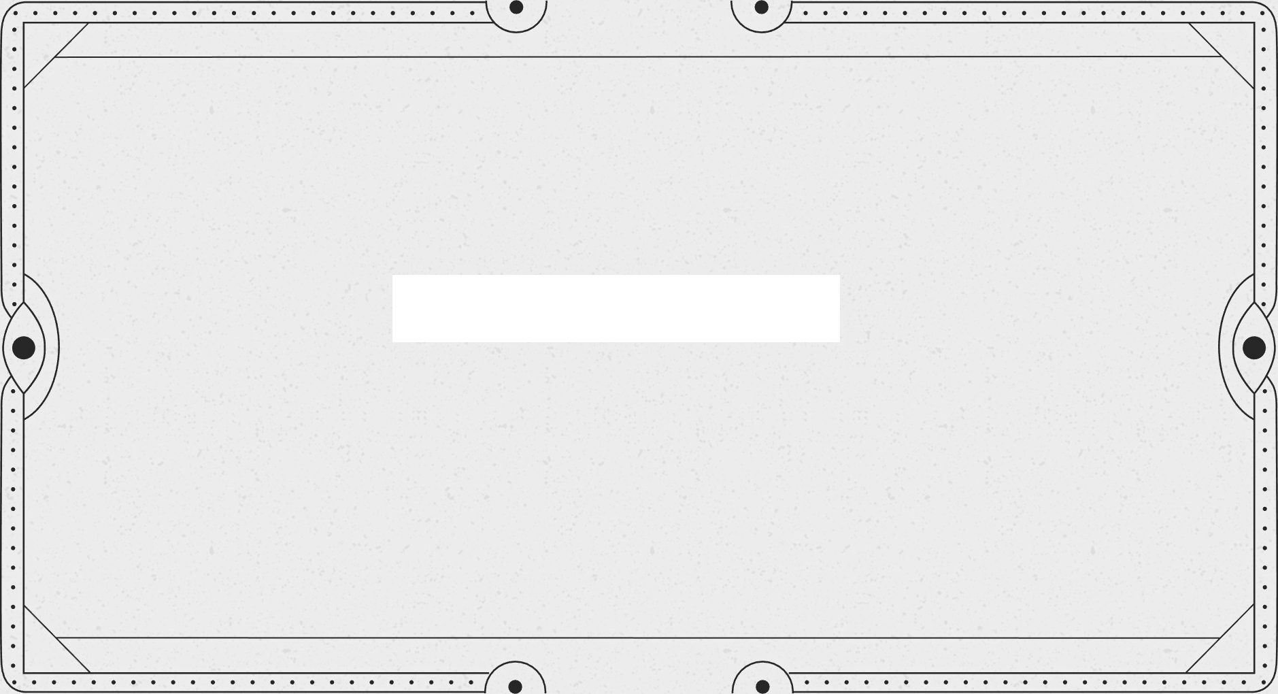
Thank You!

